Slide 1
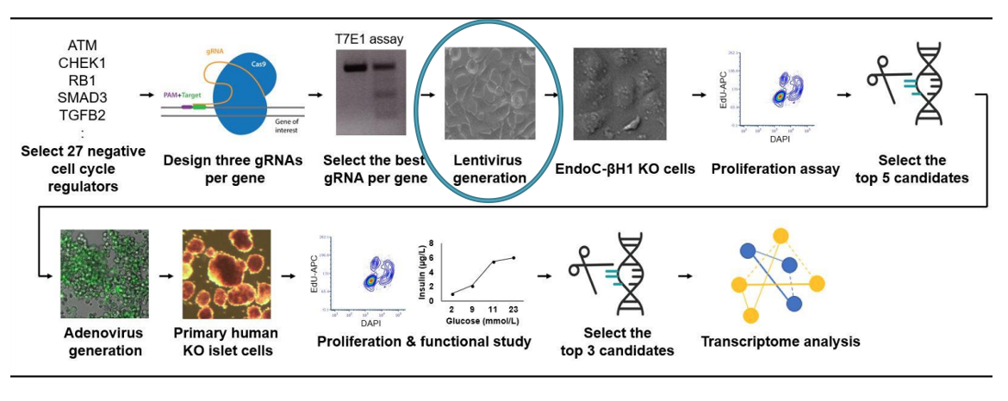
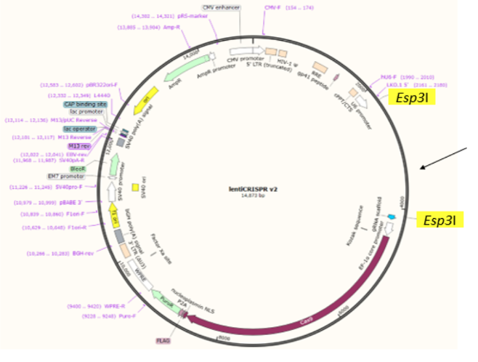
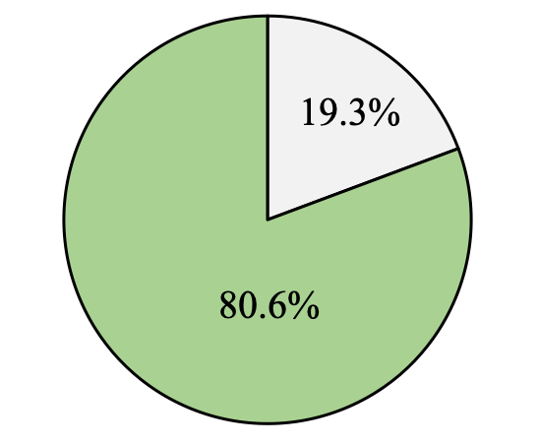
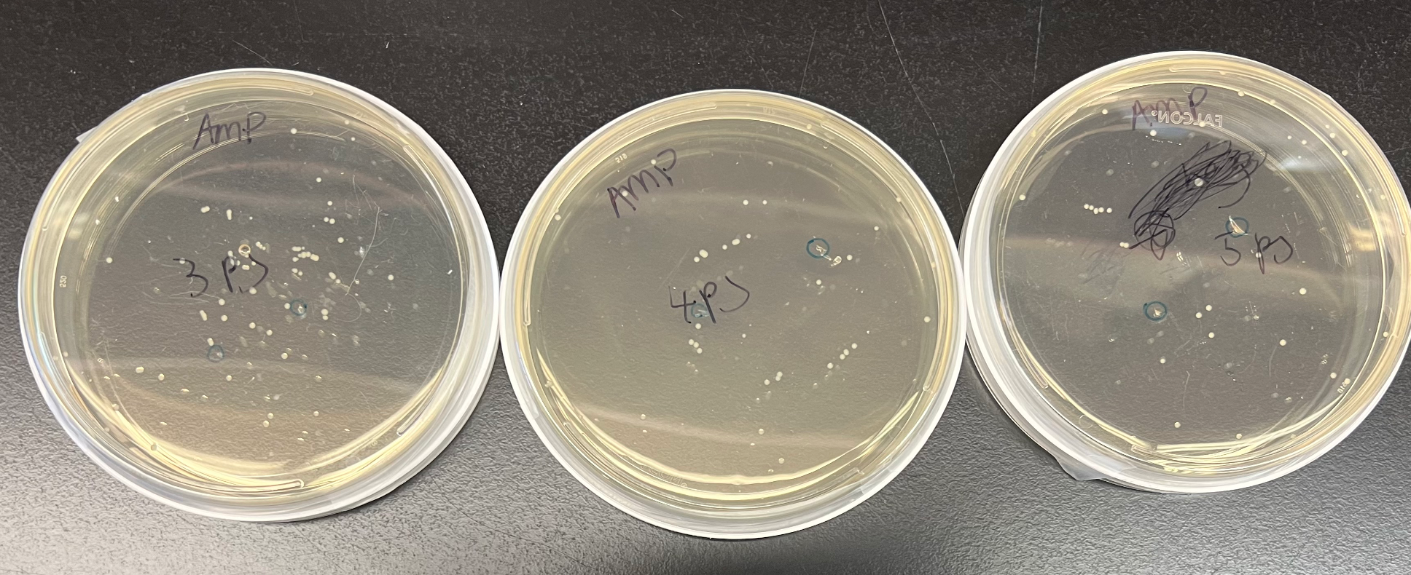
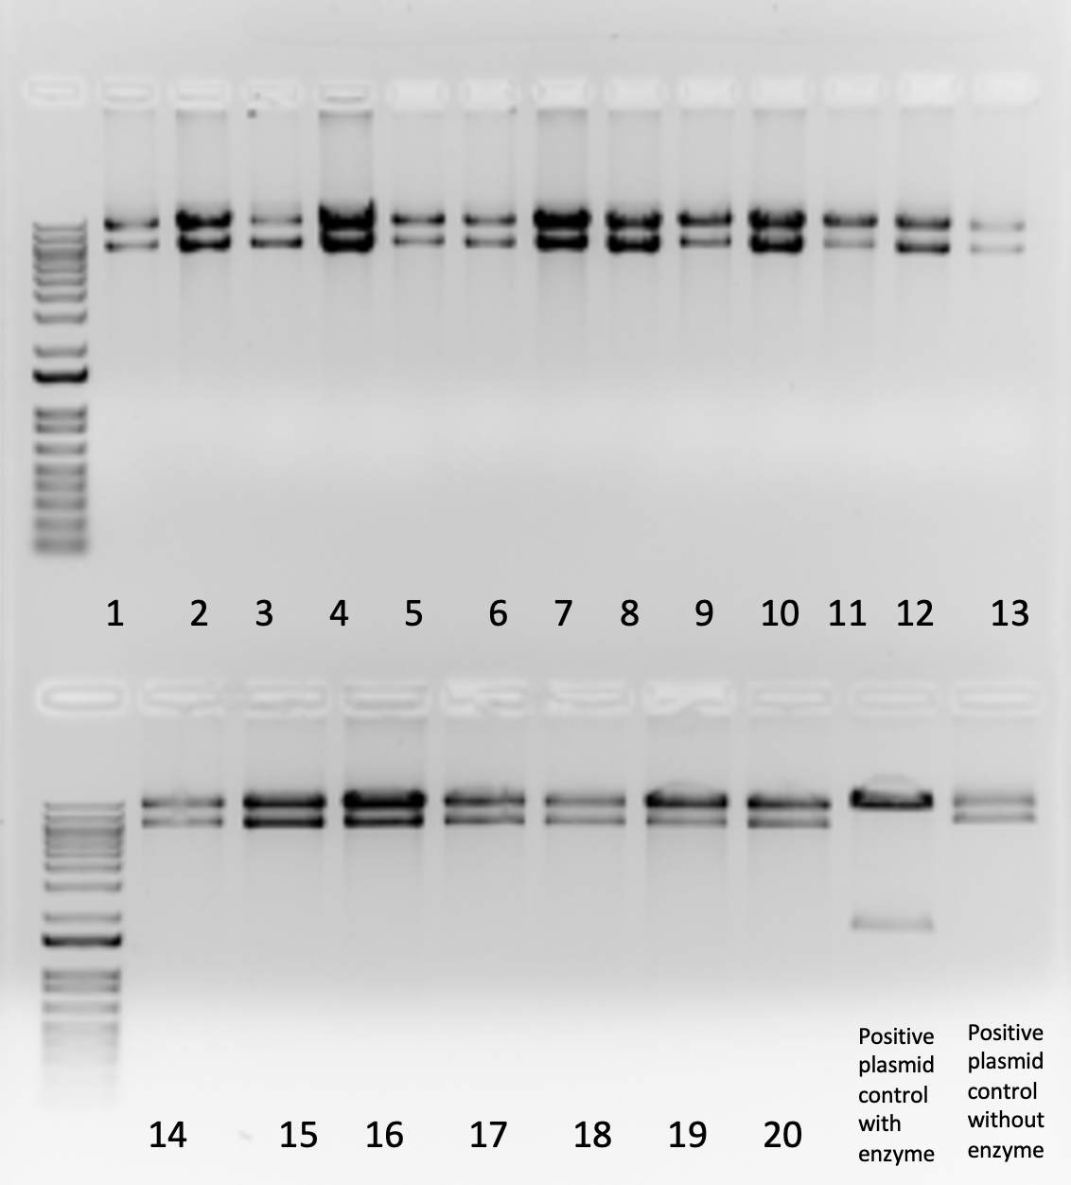
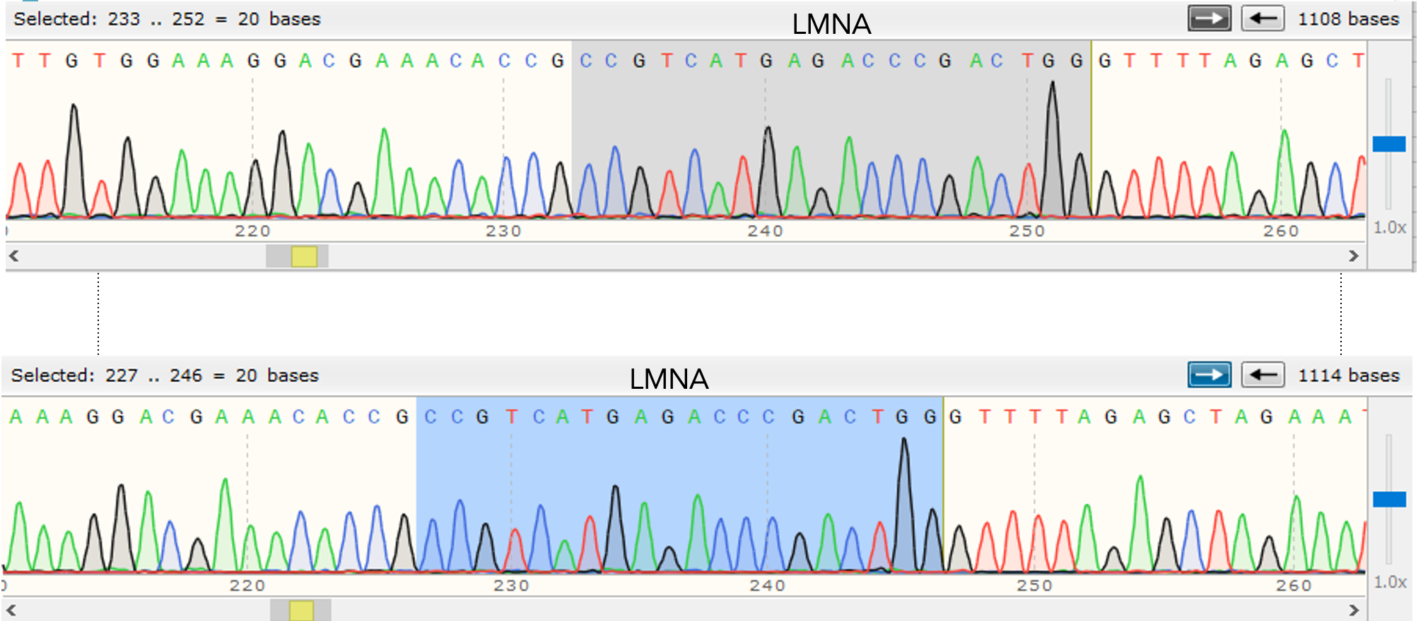
Negative Cell Cycle Regulators in Pancreatic Beta Cells
Kathryn Woodford & Project Supervisor: Hyo Jeong Yong
College of Medicine
Introduction
Diabetes is a chronic disease that affects ~442 million people worldwide. There are two forms of diabetes, type 1 and type 2. Type 1 diabetes typically appears in adolescence and takes place when the body destroys beta cells, secreting insulin. Type 2 diabetes occurs in older, and typically obese, individuals when the body does not produce enough insulin and react in the way it should. A common pathological feature between both of these types of diabetes is a lack of functional, insulin producing beta cells. Due to lack of insulin, diabetic patients need to inject insulin to help in glucose homeostasis. Without it, blood sugar levels can become dangerously high.
In order to help those suffering from diabetes, my research project is exploring negative cell cycle regulators in beta cells. When more beta cells are proliferated by inhibiting negative cell cycle regulators, more insulin is being produced thus helping regulate blood sugar levels.
To test this, we are exploring 27 candidate genes related to cell cycle arrest. Through a series of tests, we hope to narrow this group down to discover the 3 genes that reduce beta cell proliferation the most.
Before we can begin these tests though, we need to clone guide RNA targeting candidates into lentiviral plasmid expressing Cas9 gene. (Our cloning protocol + transformation + miniprep + enzyme digestion + Sanger sequencing). Then, we are able to use this lentiviral plasmid to knock out our candidate genes to compare the role of these genes in proliferation rates in beta cells.
This information can be useful to those suffering from diabetes because it can be used by pharmaceutical companies to manufacture a drug which would help increase levels of beta cell proliferation. Then, diabetic patients who took this drug would be able to produce more insulin to regulate glucose homeostasis.
Methods
This diagram depicts the methods section for the project as a whole. The
circled Lentivirus generation section is the component of the project
that I have been responsible for.
DNA Sequencing Results
These are the success rates of the cloning so far. We are trying to clone 88 genetic sequences, and we have successfully cloned 71 of these sequences. The green piece of the pie chart indicates that 80.6% of the genes have been sequenced and isolated, whereas the white part of the chart indicates that 19.3% of the genes have not yet been sequenced. . We plan on continuing the cloning step until we are able to prepare all plasmids for lentivirus generation.
This is the plasmid we will be using for our experiment. It will be cut along the highlighted regions and this is where the genetic sequence will be inserted.
Results
Colonies on ampicillin LB plates
DNA sequencing re
Pool 9 gel electrophoresis which confirm ligation
DNA sequencing results being analyzed to check whether plasmid contain right guide RNA
Conclusion and Forward Implications
We have cloned lentiviral plasmid including guide RNA sequence. On the way though, we have learned other useful technical information such as the fact that older ampicillin plates are more prone to the creation of satellite colonies. Additionally, leaving the plates to grow for too long can lead to satellite colonies. These lessons have been useful to us as we continue our project, but they can also be beneficial to other researchers.
Once cloning is complete, we will be able to move onto the next steps of the project. The goal of this project is to identify the 3 genes that reduce beta cell proliferation the most. In the case of diabetes, pharmaceutical companies can use this information to experiment with knocking out these genes. If these genes do become silenced, the beta cells will proliferate more, leading to the production of more insulin. The production of more insulin will then reduce the effects of diabetes.
Materials and Methods
Cloning (my section of the project)
Make agar plates with ampicillin
Cloning
Transformation
Plate transformed competent cells on agar plates with ampicillin. Make sure to sterilize equipment during plating to reduce the risk of contamination.
Place plates at 37 °C overnight
Place 5ml of LB including ampicillin in 20 bacteria culture tubes
Use sterile pipet tips to pick 20 individual colonies off the agar plates. Place the pipet tips with colony in each of the tubes.
Shake tubes at 37 °C
Use plasmid extraction Mini Prep kit to isolate plasmid from competent cells
Measure plasmid concentration of each tube using nanodrop machine
Then perform enzyme digestion by combining the isolated plasmid, buffer, BsmBI restriction enzyme, and water. Remember to also do a positive and negative control
Next place the tubes in 55 °C for an hour, then heat inactivation at 80 °C for 20 minutes
Then create the agarose gels for gel electrophoresis. Place 100 mL of the heated agarose in TAE buffer into a secure gel holder with combs already inside
Mix digested plasmid with loading dye
Once the gel is solidified, load samples in the gel. Remember to also do a DNA ladder
Leave the gel at around 130 V for 30 minutes
Then take a picture of the gel using UV
Analyze the picture to confirm ligation
If correct ligation is confirmed, send the plasmid off to be sequenced
References
Bacterial cell cycles and division: Encyclopedia of microbiology - credo reference. Bacterial Cell Cycles and Division | Encyclopedia of Microbiology - Credo Reference. (n.d.). Retrieved November 7, 2021, from https://search.credoreference.com/content/entry/estmicrobio/bacterial_cell_cycles_and_division/0.
Sloan, Bethel, A., Ruiz, Williamson, Vinicor, Bowman, & Quinn. (n.d.). Diabetes: Encyclopedia of Health Services Research - CREDO reference. Diabetes | Encyclopedia of Health Services Research - Credo Reference. Retrieved November 7, 2021, from https://search.credoreference.com/content/entry/sagehsr/diabetes/0.
Smillie, C., Garcillán-Barcia M. Pilar, Francia de la C., Chris Pasteur, M. E. G., M. Pilar Universidad de Cantabria. (2010, September 1). Mobility of plasmids. Microbiology and Molecular Biology Reviews. Retrieved November 7, 2021, from https://journals.asm.org/doi/full/10.1128/MMBR.00020-10.

